Slide 1

O’Neills Foyle Cup 2025
Official Group Reveal
2025

Slide 2
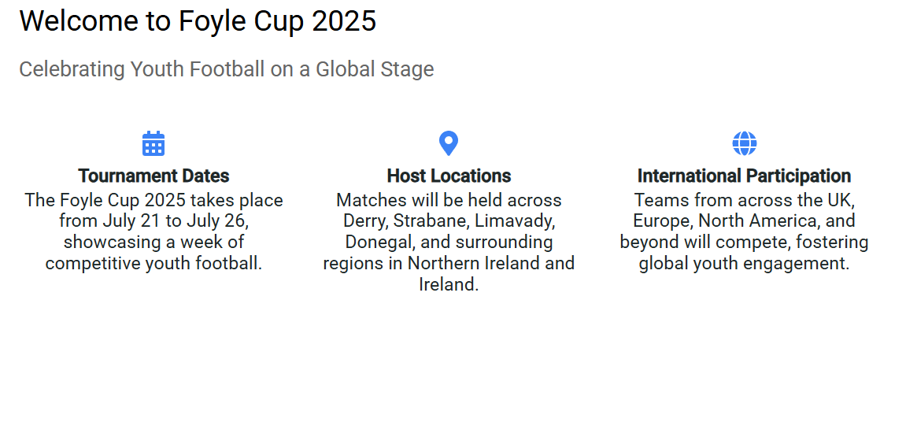

Slide 3
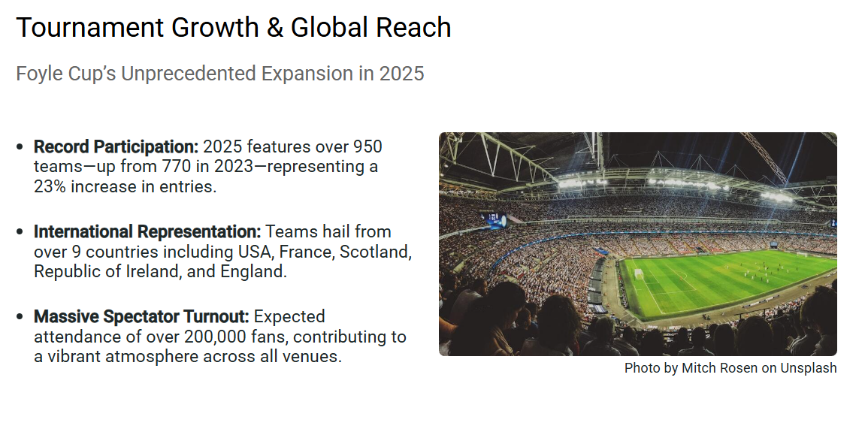
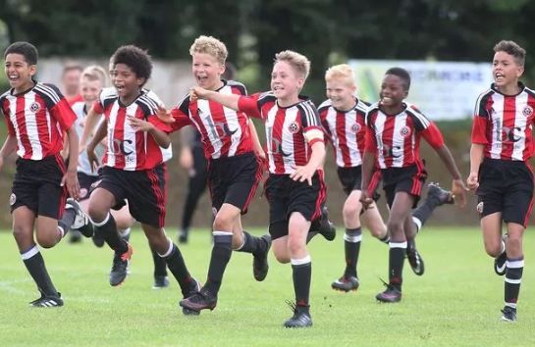

Slide 4
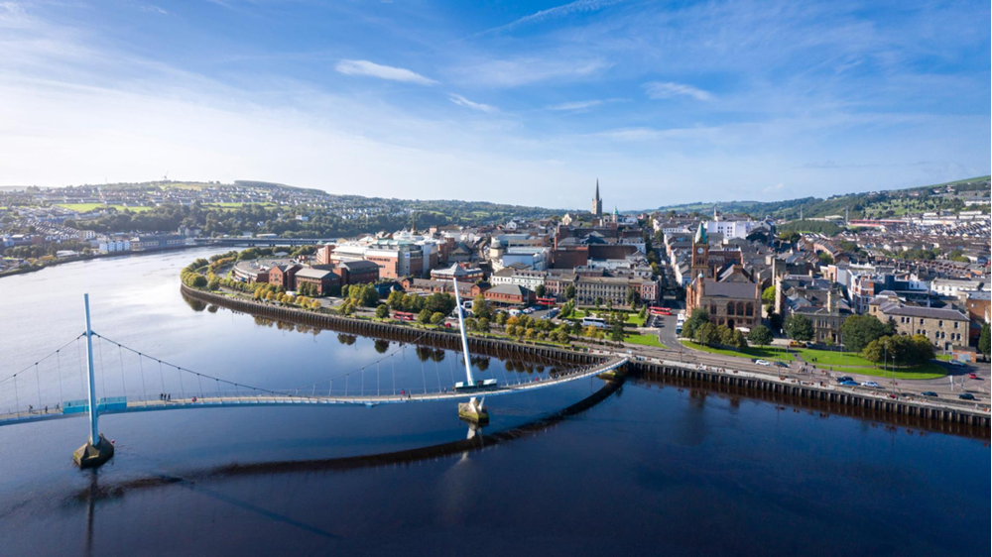
Under 8 Boys
Group A
Crusaders Jets
EastEnd Youth
Bonagee Utd
Tristar FC
Limavady Youth Colts
Top of the Hill Celtic
Group B
Moyola Park FC
Omagh Town FC
Letterbarrow Celtic
Newtowne FC
Foyle Harps
Phoenix Athletic
Group C
Ballinmallard Youth
Sion Swifts FC
Letterkenny Rovers
Strathroy Harps
Another
Limavady Youths
Group D
Portstewart Jun.
Top of the Hill Celtic Colts
Magherafelt SB Colts
Spoirt an Phobail
Newtowne FC Colts
Don Boscos Colts

Slide 5
Under 8 Boys
Group E
Limavady Y Juniors
Foyle Harps Colts
Strathroy Harps B
Maghera Strollers Colts
Portstewart Colts
Tummery Athletic Colts
Group F
Newell FC
Enniskillen Town FC
Kildrum Tigers FC
Maiden City Acad
Culmore FC
Magherafelt Sky Blues
Group G
Clifonville FC
Dergview Colts
Tristar Juniors
Phoenix Ath Colts
Quigley Point Swifts Colts
Eglinton Eagles Colts
Group H
Crusaders FC
Core Soccer
Milford Utd FC
Cockhill Celtic
Moyola Park Olympic
Tummery Athletic FC

Slide 6
Under 8 Boys
Group I
Coleraine Olympic
Trojans FC
Lagan Harps
Killen Rangers
Strabane Athletic Colts
Maghera Strollers
Group J
Eglinton Eagles FC
Bushmills Utd FC
Aileach FC
Irvinestown Wanderers
Illristin FC
Don Boscos FC
Group K
Dungannon Utd Youth
Oxford United
Cappry Rovers
Clooney FC
Portstewart FC
Buncrana Hearts
Group L
Coleraine Peacocks
Maiden City Acad Colts
Quigley Point Swifts
Strabane Athletic FC
Don Boscos Youth
Foyle Harps Jets

Slide 7

Under 8 Boys
Group M
Sion Swifts Juniors
St Patrick's (Cderg)
Core Soccer Colts
Omagh Town Juniors
Dergview FC
Tristar Colts

Slide 8
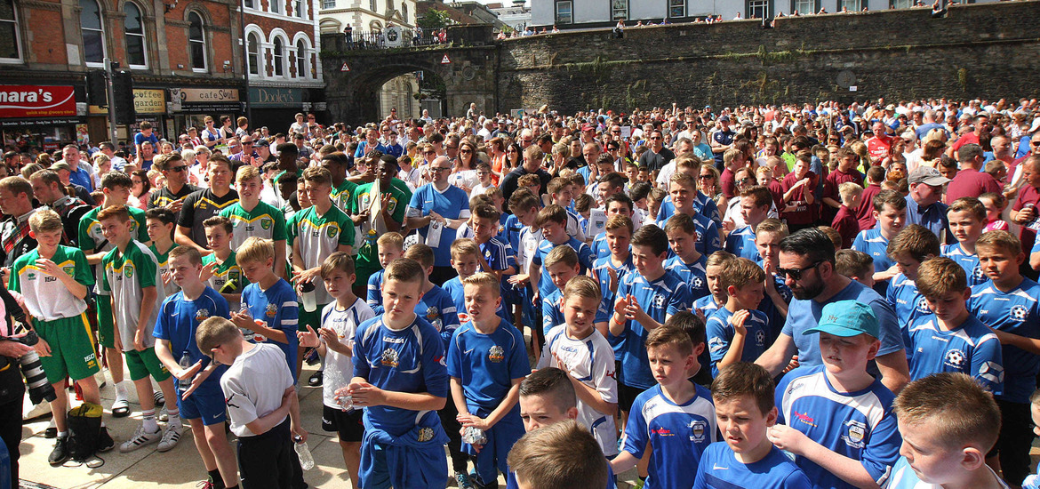
Under 9 Boys
Group A
Crusaders FC
Rathmullan Celtic
Tristar FC
Eastend
Windmill Stars FC
Letterbarrow Celtic Youth
Group B
Omagh Town FC
Redcastle Utd
Phoenix Athletic
Bonagee Utd
St Patrick C'Derg
Dungannon Utd
Group C
Ballinmallard FC
Letterkenny Rovers
Sion Swifts
Artigarvan FC
NFC Kesh
Titans FC
Group D
Glentoran
Cockhill Celtic
Core Soccer
Dungiven Celtic Colts
Tummery Ath
Dungannon Utd Colts

Slide 9
Under 9 Boys
Group E
Carrick Rangers
Drumoghill
Foyle Harps
Newtowne Yth
Castlecaufield Youth
Glentoran Colts
Group F
Coleraine Peacocks
Buncrana Hearts
Newell
Killen Rangers
Newtowne Youth Colts
Limavady Youth
Group G
Cooktown Yth
Aileach
Oxford United
Foyle Harps Youth
Castlewellan Town
Tristar Juniors
Group H
Coleraine Olympic
Sion Swifts Juniors
Strabane Colts
Stranocum Y
Fivemile Town Utd
Eglinton Eagles Juniors

Slide 10
Under 9 Boys
Group I
Magerafelt SB Athletic
Letterbarrow Celtic Colts
Culmore Colts
Portstewart Colts
Foyle Harps Colts
Maiden City Colts
Group J
Dungiven Celtic
Cappry Rovers
Trojans FC
Magerafelt SB Colts
St Patricks Colts
Stranocum Y Colts
Group K
Magherafelt SBlues
Quigley Point Swifts
Culmore FC
Ballymena Utd
Ballymoor FC
Newbuidings
Group L
Enniskillen Town
Legends Soccer Academy (USA)
Eglinton Eagles
Irvinestown Wanderers
Mountjoy Utd
Clooney

Slide 11
Under 9 Boys
Group M
Portstewart FC
Ballykeel Youth
Strabane Athletic
Bushmills Colts
Convoy Arsenal
Top of the Hill Celtic
Group O
Ballymoney YTH
Strathroy Harps
Don Boscos
Tristar Colts
Illies Celtic
Maiden City
Group P
Ballinmallard Colts
Maghera Strollers
Strathroy Harps Colts
Limavady Colts
Don Boscos Colts
Oxford United Colts
Group Q
Mountjoy Utd Juniors
Bushmills Utd
Lisbellaw
Tummery Athletic Colts
Trojans Colts
Eglinton Eagles Colts

Slide 12
Under 9 Boys
Group R
Irvinestown Wanderers Colts
Top of the Hill Celtic Colts
Maghera Strollers Colts
Limavady Utd Jun Colts
Phoenix Colts
Ballymoney Youth Colts

Slide 13
Under 10 Boys
Group A
Tristar Jets
Illstrin FC Colts
Maghera Strollers Colts
Sion Swifts Colts
Ballymoney Colts
Top of the Hill Celtic Colts
Group B
Crusaders
Moville Celtic
Bonagee Utd
Strabane
Newtowne
Maghera Strollers
Group C
Crusaders Colts
Glen Rovers
Sion Swifts Fc
Don Boscos
Killen Rangers
Strathroy Harps
Group D
Coleraine Olympic
Aileach FC
Milford Utd FC
Ballymoor FC
Kildrum Tigers
Greencastle Utd Braves

Slide 14
Under 10 Boys
Group E
Carndonagh Colts
Trojans Colts
Don Boscos Yth
Newtowne Y Colts
Shankill Colts
Kilmore Rec Juniors
Group F
Glentoran TC
Greencastle Utd
Ballyraine FC
Newell FC
NFC Kesh
Newcastle Town
Group G
Larne FC
Ballybofey Utd FC
Tristar FC
Ballymacash Rangers
Foyle Harps FC
Kilrea Utd
Group H
Ballinmallard
Lifford Celtic
Core Soccer
Clooney
Shankill Youth
Maiden City

Slide 15
Under 10 Boys
Group I
St Oliver Plunkett Juniors
Phoenix AthleticColts
Foyle Harps Youth
Omagh Town FC
Letterkenny Crusaders
Ballinmallard Colts
Group J
Dergview
Letterkenny Rovers
Trojans
Enniskillen Town
Phoenix Athletic
St Oliver Plunkett FC
Group K
Portrush FC
Cockhill Celtic
Culmore FC
Ballymoney Youth
Dungiven Celtic
East End Youth
Group L
Portstewart
Illstrin
Eglinton Eagles
Tummery Athletic
Cumann Spoirt an Phobail
Killylough FC

Slide 16
Under 10 Boys
Group M
Kilmac Youth Academy
Ballymoney Y Ath
Sion Swifts Jets
Limavady Y Colts
Maiden City Colts
Strabane Ath Colts
Group N
Patrumo (USA)
Kilmac Celtic
Oxford United
Heights Utd
Eglinton Eagles Colts
Moyola Park Youth
Group O
St Patricks (C’derg)
Buncrana Hearts
Dungannon Utd Colts
Windmill Stars
Limavady Olympic
Moyola Park Olympic
Group P
Don Boscos Colts
Oxford United Juniors
St Oliver Plunkett Colts
Foyle Harps Colts
Sion Swifts Youth
Cumann Spoirt an Phobail Colts

Slide 17
Under 10 Boys
Group Q
Mulroy Academy
Carndonagh
Irvinestown Wanderers
Mountjoy Utd
Moyola Park Colts
Portadown
Group R
Dungannon Utd
Redcastle Utd
Kilmore Rec
Culdaff FC
Top of the Hill Celtic
Limavady Utd
Ards Academy
Group S
Glen Rovers Colts
East End Juniors
Tristar Colts
Oxford UnIted Colts
Portstewart Colts
Tummery Colts
Eglinton Eagles Jets

Slide 18
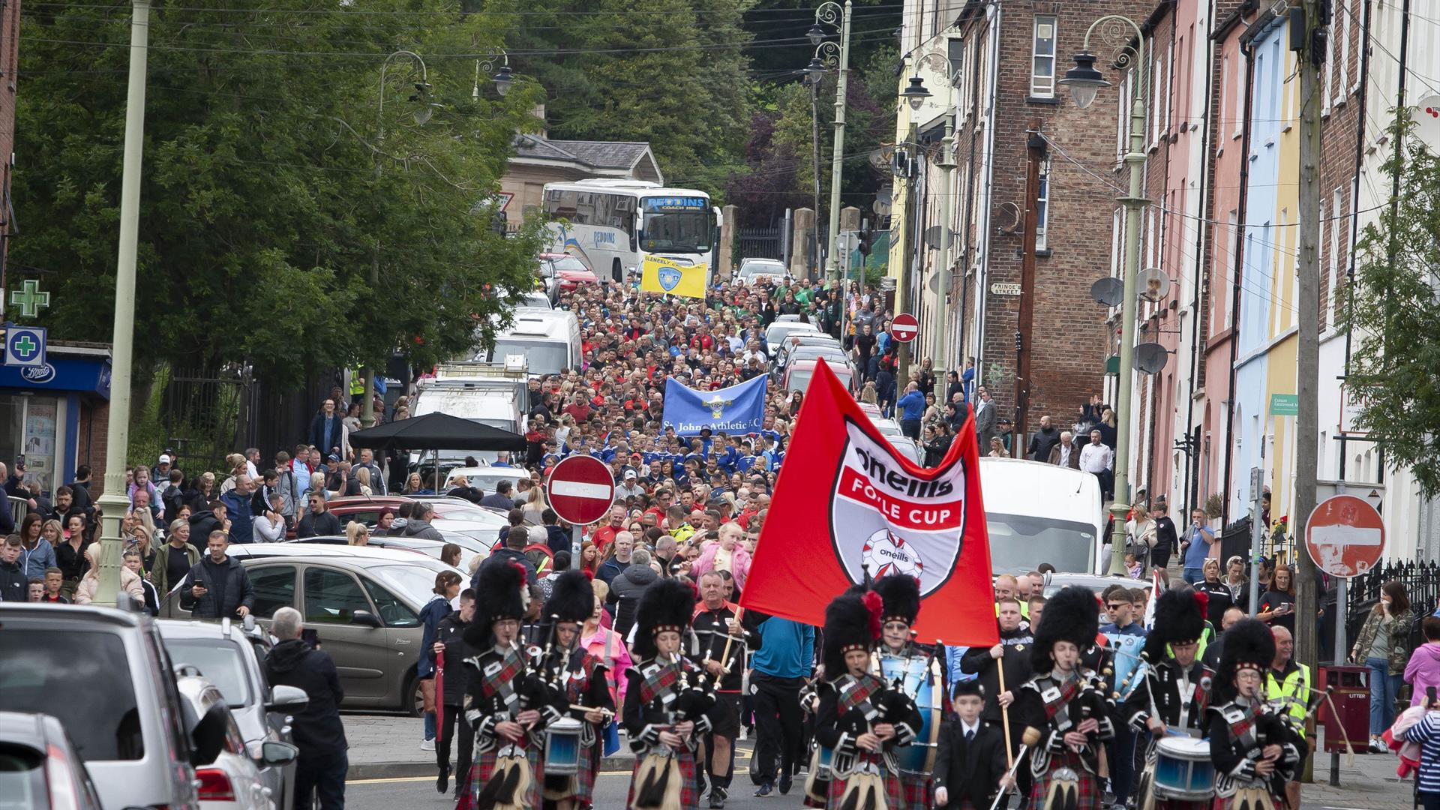
Under 11 Boys
Group A
Ballinmallard Y. Colts
Tummery Athletic Jun
Rosario Colts
Trojans Colts
Magherafelt SB Colts
Phoenix Colts
Group B
Glenavon FC
Surf Select (USA)
Strabane Athletic
Lisdrum Youth
Magherafelt SB
Redcastle Utd
Group C
Draperstown Celtic
Rosario FC
Trojans FC
Windmill Stars
Stranocum Youth
Cappry Rovers
Group D
Newry City FC
Newbuildings FC
Top of the Hill Celtic
St Patrick (B'Fast)
Tummery Athletic FC
Quigley Point Swifts

Slide 19
Under 11 Boys
Group E
Patrumo FP (USA)
Dungannon Colts
Tristar Colts
NFC Kesh
St Malachy's OB
Moville Celtic FC
Group F
Magherafelt SB Jets
Castlecaulfied Colts
Illstrin Colts
Ballymoney Y Athletic
Newbuildings Colts
Maiden City Colts
Group G
Cliftonville Jets
Ballymoney Youth
Dungiven Celtic
Moyola Park Youth
Camlough Rovers
Letterbarrow Celtic
Group H
Coleraine FC
Lurgan Town FC
Dergview FC
Maiden City
Beragh Swifts
Eglinton Eagles

Slide 20
Under 11 Boys
Group I
Coleraine Colts
Top of the Hill Celtic Colts
Cookstown Youth Colts
Foyle Harps Juniors
Rosario Juniors
Limavady Utd Colts
Group J
Limavady Utd
Irvinestown Wanderers
Strathroy Harps
Mountjoy Utd
Bonagee Utd
Culmore
Group K
Portadown FC
East End Youth
Tristar FC
Maghera Strollers
Glen Rovers FC
Killen Rangers FC
Group L
Coleraine Olympic
Kilmore Rec. Juniors
Maghera Strollers Colts
Strabane Athletic Colts
Foyle Harps Colts
Ballymoney youth Colts

Slide 21
Under 11 Boys
Group M
Dungannon Utd
Phoenix Athletic
Cookstown Youth
Aileach FC
Don Boscos Colts
Milford Utd
Group O
Loughgall Youth
Sion Swifts FC
Aquinas FC
Lagan Harps FC
Ballyraine FC
Omagh Town FC
Group P
Tummery Ath Colts
Dungiven Celtic Colts
Carryduff Colts
Eglinton Eagles Colts
East End Youth Juniors
Sion Swifts Colts
Group Q
Ballinmallard Utd
Foyle Harps
St Oliver Plunkett FC
Illstrin FC
Cumann Spoirt an Phobail
Kilmore Rec.

Slide 22
Under 11 Boys
Group R
NE Academy (USA)
Newell FC
Portstewart FC
Inishowen Youth
Letterkenny Rovers
Castlecaulfield Y
Group S
Enniskillen Town
Clooney FC
Castlecaulfield Y Colts
Lagan Harps
Enniskillen Rangers
Don Boscos FC
Group T
Glendowan Ath
East End Y Colts
Loughgall Y Colts
Ballyraine Colts
Ballymoor FC
Tristar Jets

Slide 23
Under 12 Boys 9v9
Group A
Ballymoney Youth Acad
Tummery Ath Colts FC
Camlough Rovers FC
Phoenix Athletic FC
Sion Swifts FC
Maghera Strollers FC Colts
Group B
Strathroy Harps FC
Strabane Ath FC Colts
Lisbellaw Utd
Cockhill Celtic FC
Buncrana Hearts Colts
Curragh Athletic
Group C
Dungannon Utd
Culmore FC
Top of the Hill Celtic Colts
Letterbarrow Celtic Youth
Portstewart Utd FC
Magherafelt Sky Blues
Group D
Dunaghy Youth
St Patricks Colts (Cderg)
Lagan Harps FC
St Marys FC Belfast
Mountjoy Juniors FC
Ballycastle Youth Academy

Slide 24
Under 12 Boys 9v9
Group E
Redcastle Utd
Enniskillen Town FC
Foyle Harps FC Colts
Eglinton Eagles FC Colts
Top of the Hill Celtic
Northend Utd FC
Group F
Eglinton Eagles FC
St Patricks FC (Cderg)
Maghera Strollers FC
Newhill FC
Tummery Athletic FC
Newcastle Town FC
Group G
Ballymoney Youth Ath.
Strabane Athletic FC
Antrim Soc Academy
Foyle Harps FC
Dungiven Celtic Colts
Ballyraine FC

Slide 25
Under 12 Boys 11v11
Group A
Sandyrow FC
East End FC
Bonagee Utd FC
Tristar FC
Group B
Tristar FC Colts
Lifford Celtic
St. Oliver Plunkett FC
Aileach FC
Group C
Sion Swifts FC
St. James' Swifts FC
Newhill FC Colts
Raphoe Town
Group D
Letterkenny Rovers FC
Ballinamallard Utd Youth
Portrush FC
Cookstown Y FC

Slide 26
Under 12 Boys 11v11
Group E
Illistrin FC
Lisnaskea FC
Oxford Utd Stars
Drumoghill Utd FC
Group F
Newry City FC
Trojans FC
Goodlad Academy USA
Coleraine FC
Group G
Maiden City Soccer
Portadown FC Youth
Limavady utd Youth
Lisburn RTC
Group H
Limavady Utd YouthColts
Dunree FC
Don Boscos FC
Ballybofey Utd

Slide 27
Under 12 Boys 11v11
Group I
Castlewellan Town FC
Donegal Underage L.
Clooney FC
Don Boscos Colts
Group J
Larne FC
Inishowen Youth
Cumann Spoirt an Phobail FC
Tristar FC Jets
Group K
Dungannon Utd
Glenavon FC
Newell FC
Maiden City Juniors
Group L
Draperstown Celtic
Glen Rovers
Castlecaulfield Youth FC
Shankill Youth

Slide 28
Under 13 Boys
Group A
Portstewart Utd FC
Maiden City Acad.
Redcastle FC
Illistrin FC
Group B
Patrumo FP USA
St Marys YFC
St Oliver Plunketts FC
Trojans FC
Group C
Newell FC
Top of the Hill Celtic
Magherafelt Sky Blue Y. Colts
NFC Kesh FC
Group D
Dungiven Celtic FC
Sion Swifts FC
Foyle Harps FC Colts
Donegal Underage L.

Slide 29
Under 13 Boys
Group E
Newbuildings Utd FC
Eglinton Eagles FC
Cappry Rovers
Crumlin Star Colts
Group F
Camlough Rovers FC
Altrincham FC
Limavady Youths FC
Cookstown Youths FC
Group G
Quigley Point Swifts
Ardstraw Youth
Maghera Strollers FC Colts
Rathfriland FC Youth
Group H
Mountjoy Juniors FC
Don Boscos FC
Coleraine Alexandra FC
Letterkenny FC

Slide 30
Under 13 Boys
Group I
Partick Thistle FC
Castlefin Celtic FC
St Patrick's FC Cdreg
Dungannon Utd Swifts
Group J
Clooney FC
Sion Colts FC
Portrush FC
Tristar FC Colts
Group K
St Malacy's OB Cosmos
Tummery Athletic FC
Strabane Athletic Colts
IFA Girls Devel Sq.
Group L
Limavady Youth Colts
St Malachys OB
Inishowen Youth L
Donegal Town FC

Slide 31
Under 13 Boys
Group M
Tristar FC
Heights Youth FC
Phoenix Athletic FC
Portadown FC Youth
Group N
Antrim Soccer Academy
Foyle Harps FC
Ballycastle Youth Acad
Glen Rovers FC
Group O
Crumlin Utd
Eastend Youth FC
Culmore FC
Maghera Strollers FC
Group P
Dungannon Utd Youth
St Oliver Plunketts FC Colts
Irvinestown Youth FC
Strabane Athletic FC

Slide 32
Under 14 Boys
Group A
Club Mercenarios (Spain)
Derry City FC
Hibernians FC (Scot)
Coleraine FC
Group B
Glenea Utd FC
Oxford Utd Colts
Coleraine FC Colts
Eglinton Eagles FC
Group C
Maghera Strollers FC
Tummery Ath FC
Moyola Park FC
Enniskillen Rangers
Group D
Culmore FC
Portrush FC
East Donegal Youth
Strathroy Harps FC

Slide 33
Under 14 Boys
Group E
Cootehill Harps FC
Inishowen Youth L.
Limavady Utd Youth
Castlecaulfield YFC
Group F
Blantyre Soccer Acad
St Oliver Plunkett FC
Illistrin FC
Maiden City Acad.
Group G
Hillsborough Boys FC
Moville Celtic FC
Tristar FC Colts
Clooney FC
Group H
Magherafelt Sky Blue Colts
Dunree FC
Bonagee Utd FC
Top of Hill Celtic

Slide 34
Under 14 Boys
Group I
Partick Thistle FC
Cliftonville FC
Finland FDS
Ballymena Utd
Group J
Don Boscos FC
Ballyraine FC
Portstewart FC
Draperstown Celtic FC
Group K
Derriaghy Youth
Triangle Stars
Donegal Underage L
Tristar FC
Group L
Phoenix Athletic FC
Limavady Utd Colts
Sion Swifts FC
St Marys Ath FC

Slide 35
Under 14 Boys
Group M
Ballymoney Youth FC
Trojans FC
St Patrick's FC Cderg)
Newington FC
Group N
Don Boscos Colts
Warrenpoint Town FC
Limavady Utd Olympic
Glendowan FC
Group O
Oxford United
Ballinmallard
Loughgall
Donegal NW Select

Slide 36
Under 15 Boys
Group A
Imaculata FC
Sion Swifts FC Colts
Aquinas FC
Ballymoney Youth Athletic
Group B
Letterkenny Rovers
East End FC
Ardstraw Youth
Dergview FC
Group C
FDS Finland
Draperstown Celtic Colts
St Oliver Plunkett FC
Eastend Youth FC
Group D
Mountjoy Juniors FC
Inter Conneticut
Phoenix Athletic FC
Kerry Schoolboys L.

Slide 37
Under 15 Boys
Group E
Draperstown Celtic FC
Newell FC
Strathroy Harp FC
Sion Swifts FC
Group F
Top of the Hill Celtic
Irvinestown Wanderers
Don Boscos FC
Ballymoney Youth Acad
Group G
Coleraine FC
Swilly Rovers
St Patricks FC (Cderg)
St Oliver Plunkett FC Colts
Group H
East Donegal Youth
Clooney FC
Strabane Athletic FC
Inishowen Youth L.

Slide 38
Under 15 Boys
Group I
Newry City FC
Kilmacrennan Celtic
Larne FC
Tristar FC
Group J
Ballycastle
Tummery Athletic FC
Limavady Utd Youths
Trojans FC

Slide 39
Under 16 Boys
Group A
Portstewart Utd FC Colts
Culmore FC
Dundalk SL
Maiden City Acad
Group B
Glendowan FC
Portstewart Utd FC
Ballyclare Comrades
Institute FC
Group C
Bonagee Utd
Beragh Swifts
Oxford Utd Stars
Top of the Hill Celtic
Group D
Annagh Utd
Strabane Athletic FC
Club Mercedarios FC
Realta na Cromoige

Slide 40
Under 16 Boys
Group E
Tummery Athletic FC
Another
Moyola Park FC Colts
Trojans FC
Group F
Quigley Point Swifts
Ballymoney Youth Academy
Limavady Utd youth
Moyola Park FC
Group G
Donegal Underage L.
Coleraine FC
Letterbarrow Celtic Youth
Phoenix Athletic FC
Group H
Cappry Rovers FC
Lifford Celtic
Moville Celtic FC
Oxford Utd Colts

Slide 41
Under 17 Boys
A
Altringham FC
Erne Coaching Acad.
Dunree Utd Fc
Don Boscos FC
B
Letterkenny Rovers FC
Camlough Rovers FC
Tristar FC
Northwood FC (Eng)
C
Maiden City Acad
Letterbarrow Celtic FC
Antrim Soc Acad.
Clooney FC
D
Institute FC
George Royal AC (S.A.)
Cockhill Celtic FC
Strathroy Harps FC

Slide 42
Under 17 Boys
E
Moyola Park Fc
Sion Swifts FC
Fivemiletown FC
Ballymoor FC
F
Bonagee Utd FC
Cookstown Utd FC
Don Boscos FC Colts
Newbridge Town FC

Slide 43
Under 19 Boys
A
Dungannon Swifts
Donegal Underage L.
Don Boscos FC
Killen Rangers FC
B
Institute FC
Cromac Celtic
Culmore FC
Dergview FC
C
Oxford Utd Stars
Cockhill Celtic FC
Maiden City
Cappry Rovers
D
Lifford Celtic FC
Top of the Hill Celtic
Limavady Utd Y. Colts
Tummery Athletic FC

Slide 44
Under 19 Boys
E
Limavady utd Youth
Carndonagh FC
Mountjoy Juniors FC
Foyle Harps FC
F
Strabane Athletic FC
Buncrana Hearts
Newtowne FC
Crumlin Stars
G
Quigley Point Swifts
Beragh Swifts
Phoenix Athletic
Newington FC

Slide 45
Under 9 Girls
Group A
Sion Swift Twisters
Tristar FC
Institute Belles
Crusader Strikers Blacks
Coleraine FC
Dungiven Celtic FC
Group B
Dungiven Celtic FC Colts
Crusader Strikers
Tristar FC Colts
Magherafelt Sky Blues
Greencastle FC
Don Boscos FC
Group C
Illistrin FC
Enniskillen Town FC
Phoenix Athletic
Mid Ulster Ladies
Linfield FC
Ballymoney Youth Acad.
Group D
Irvinestown Wanderers
Top of the Hill Celtic
Bonagee Utd FC
Sion Swift Whirlwinds
Limavady Utd Youth
Another

Slide 46
Under 10 Girls
Group A
Linfield FC
Maiden City Acad
Strabane Athletic FC
Crusaders FC
Top of the Hill Celtic
Group B
Belfast Swifts
Phoenix Athletic Colts
Strabane Ath. FC Colts
Mid Ulster Ladies
Tummery Ath FC Colts
Group C
Ballymoor Bellas
Coleraine FC
Sion LadiesTornadoes
Greencastle FC
Milford Utd FC
Group D
Newbuildings Utd FC
Dungiven Celtic FC
Magherafelt Sky Blues
Tristar FC
Limavady Utd Youth

Slide 47
Under 10 Girls
Group E
Tummery Athletic FC
Eglinton Eagles FC
Phoenix Athletic
Tristar FC Colts
St Marys

Slide 48
Under 11 Girls
Group A
Lisbellaw Girls
Dergview FC
Another
Tristar FC Colts
Strathroy Harps FC
Group B
Augher Stars FC
Sion Ladies Cyclones
Irvinestown Wanderers
Carndonagh Girls
Lagan Harps FC
Group C
Tristar FC
Ballymena Utd FC
Patrumo FP (USA)
Crusader Strikers
Greencastle FC
Group D
Cockhill Celtic FC
Magherafelt Sky Blues
Aileach FC
Crusader Knights
Another

Slide 49
Under 11 Girls
Group E
Quigley Point Swifts
Coleraine FC
Institute Belles FC
Lisnaskea Rovers FC
Buncrana Hearts FC
Group F
Kildrum Tigers FC
Phoenix Athletic FC
Ballymoney Youth Acad.
Illistrin FC
Donegal L. Colts
Group G
Eglinton Eagles FC
Ballinamallard Uts Youth
Limavady Utd Youth
Donegal L
Rosario FC

Slide 50
Under 12 Girls
Group A
Coleraine FC
Tristar FC
St Malachy's OB
Don Boscos Colts
Newbuildings
Group B
Ballymoney Youth
Sion Ladies Hurricanes
Tristar FC Colts
Eglinton Eagles
Top of Hill Celtic
Group C
Phoenix Athletic
Don Boscos FC
Letterkenny Rovers
Maiden City Acad
Cumainn Spoirt an Phobail
Group D
Eglinton Eagles Colts
St Oliver Plunkett FC
Top of Hill Celtic Colts
Maghera Strollers
Donegal L.

Slide 51
Under 12 Girls
Group E
Dungiven Celtic FC
Phoenix Athletic Colts
Ballymoor Bellas
Maiden City Acady Colts
Cappry Rovers
Group F
Limavady Youth
Lisbellaw Utd
Aileach FC
Tummery Athletic
Donegal L Colts

Slide 52
Under 13 Girls
Group A
St Malachy's OB
St Oliver Plunkett FC
Tummery Athletic FC
Tristar FC
Donegal L
Group B
Eglinton Eagles FC
Culdaff FC
Lagan Harps FC
Strathroy Harps FC
Belfast Swifts Colts
Group C
Ballinamallard Utd Girls
Dergview Utd FC
Lisbellaw Utd
Ballyraine Harps FC
Cliftonville FC
Group D
Carryduff Girls
Moville Celtic FC
St Malachy's OB Cosmos
Irvinestown Wanderers
Bonagee Utd FC

Slide 53
Under 13 Girls
Group E
Carrick Rangers FC
Institute Belles
Milford Utd FC
Sion Ladies Sparks
Coleraine FC
Group F
Buncrana Hearts FC
Belfast Swifts
Donegal L Colts
Limavady Utd Youth
Ballymoney Youth

Slide 54
Under 14 Girls
Group A
Phoenix Athletic
Limavady Utd Girls
St Oliver Plunkett
Sion Ladies Flames
Eglinton Eagles FC
Group B
Goodlad Soccer
Dungiven Celtic FC
Tristar FC
St Oliver Plunket Colts
Don Boscos FC
Group C
Mid Ulster Ladies
Ballymoor Bellas
Clonmany Shamrocks
Don Boscos Colts
Maiden City
Group D
Sion Ladies Lightning
Belfast Swifts
Augher Stars
Castlewellan Town
Donegal L

Slide 55
Under 15 Girls
Group A
Buncrana Hearts FC
Institute Belles
Loughgall Lakers FC
Larne FC
Group B
Tristar FC
Camlough Rovers
Dunree FC
Milford Utd FC
Group C
Moyola Park Bluebells
Gleneely Colts
Portrush FC
Lisbellaw Girls
Group D
Derry City Ladies
Tummery Athletic
Coleraine FC
Lagan Harps FC

Slide 56
Under 15 Girls
Group E
Sion Ladies
Ballymoney Youth Acad
Convoy Arsenal
Donegal L

Slide 57
Under 17 Girls
Group A
Donegal L
Quigley Point Swifts
Limavady Utd
Derry City L Colts
Group B
Derry City Ladies
Sea Rovers
Sion Ladies
Phoenix Athletic

